Slide 1
Introducing Turnitin Similarity
A special event for Unicheck customers
April 18, 2023

Slide 2

Housekeeping
A few points before we get started
All participants are muted
Please use the Zoom Webinar Q&A to submit questions and feedback
Post your questions at any time!
Webinar recording will be emailed and posted afterwards

Slide 3

Agenda
What to expect from today’s webinar
Welcome
Overview of Similarity
Demo
Migration overview
Additional resources, Q&A

Slide 4


Welcome and introduction
Gretchen Hanson
Director, Product Marketing
Michael Tesauro
Principal, Product Marketing Manager

Slide 5
Introducing Turnitin Similarity
Comprehensive plagiarism detection

Slide 6



The Turnitin Difference
The most Comprehensive coverage.
Quick, clear results. Reports generate in minutes
Modern and reliable platform. 99.9% reliability

Slide 7



Addressing Your Needs
Prevent copy/paste plagiarism
Check for
student collusion
Implement
at scale

Slide 8



Flexible and scalable workflow
Supports multiple file types
Integrated into your workflow
Seamless user experience

Slide 9





The Turnitin Cloud Platform
Modern and Accessible and Responsive
Powerful, Scalable, and Reliable
Seamless
Interoperability
Local Data
Centres
GDPR and SOC 2 Compliant
Secure and
Private

Slide 10





Comprehensive Plagiarism Detection
Safeguard Your Reputation
Unparalleled
Matching
Expose Text Manipulations
Seamless Integrations
Notes:
Win: A single slide to provide overview into major value propositions of Turnitin Originality
Turnitin Originality is the new standard in academic integrity. It’s designed to address emerging trends and help you to identify and combat them. Originality builds on Turnitin’s long history of discoverying text similarity from known sources, but goes further by identifying when text has been manipulated. It will also use sophisticated technology, such as forensic linguistics, to help identify when work - which doesn’t match known sources - has not been written by the author. But most importantly, no matter if your a student, instructor or administrator, Turnitin helps to surface actionable insights, where and when you need them to help keep integrity at the core of the work you do.

Slide 11
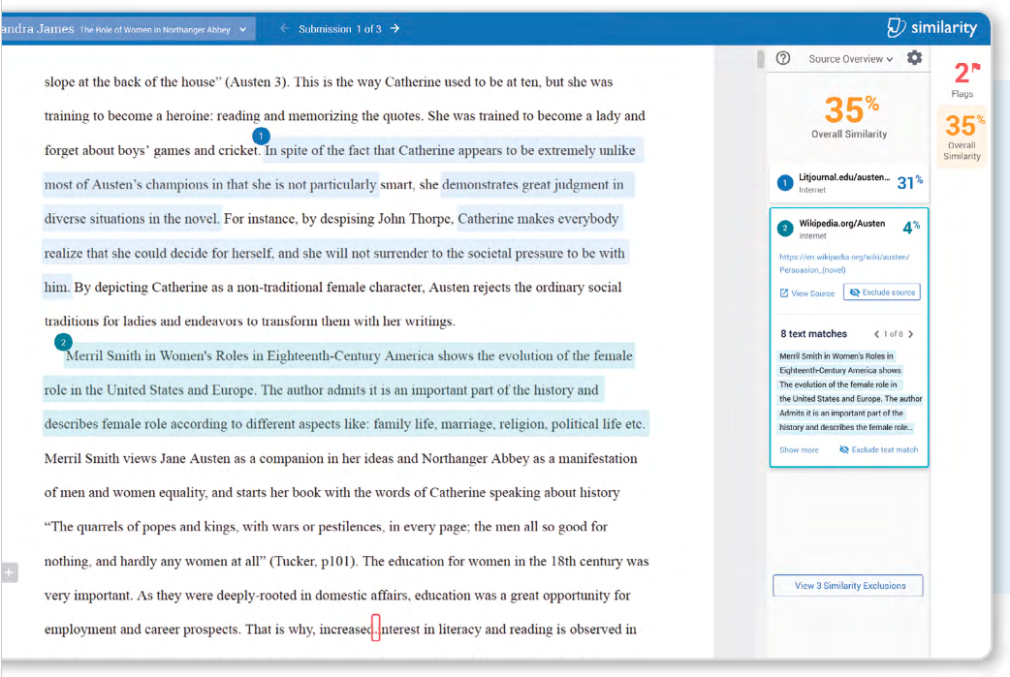
—
Discover Similarity
to Known Works
Text matching against the largest database of known content:
99 billion current and archived internet pages
85 million scholarly publications
1.8 billion student papers
Institutional repository

Slide 12
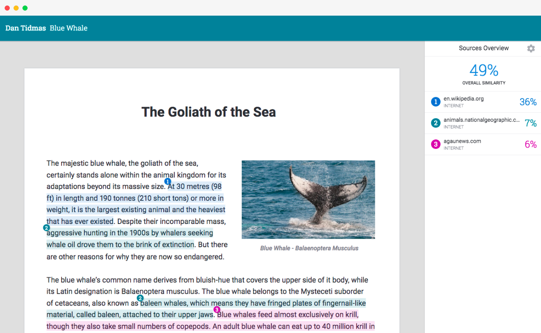
Intuitive and Accessible
WCAG AA accessible and responsive for mobile devices
Author and paper details at a glance
Your Similarity Report! Easy to interpret and customizable
Fully rendered
PDF, with color-coded highlighted matches & preserved formatting

Slide 13
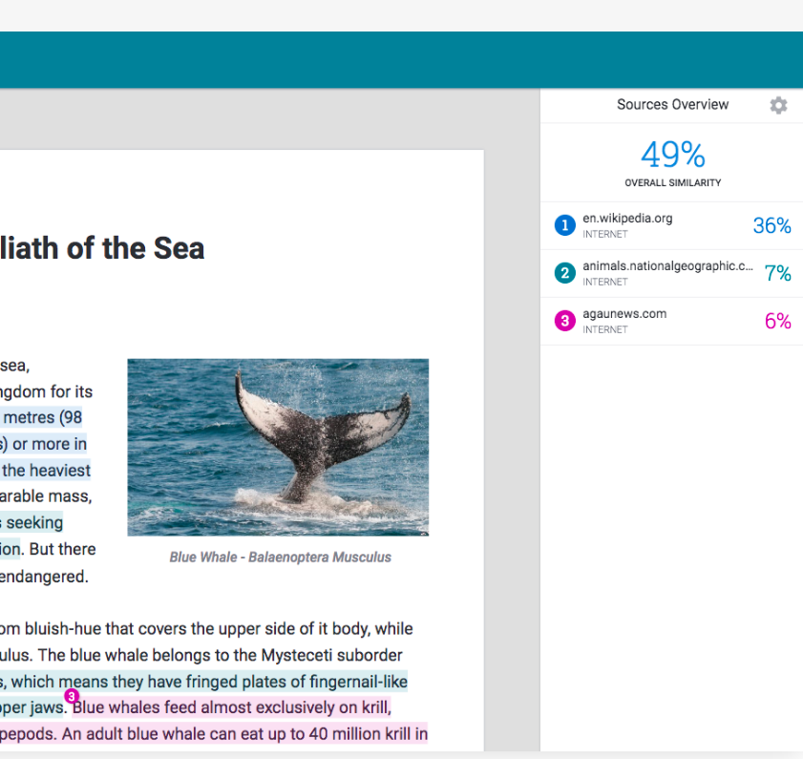
Review all matching sources
—
The sidebar shows the Sources Overview.
Each source is color-coded and matches the in-document text highlights so you can attribute a match to a website or student paper.

Slide 14
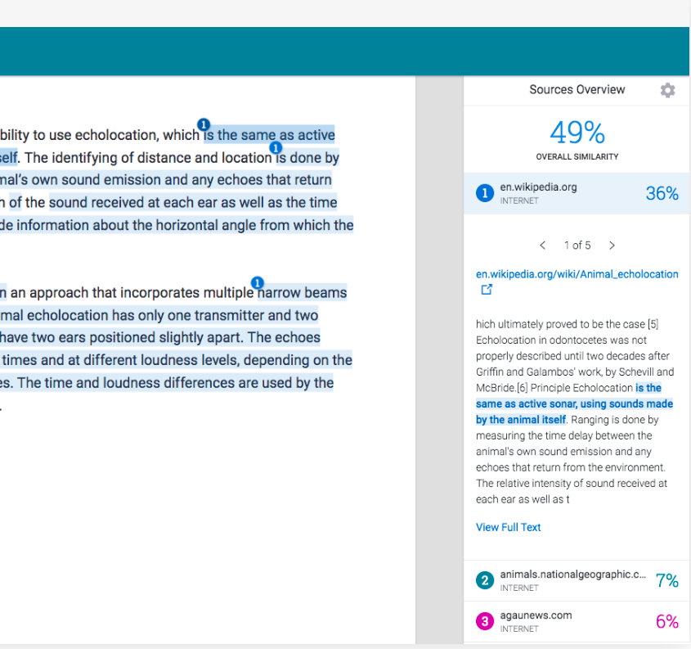
Explore matches in more detail
—
Easily scroll through multiple matches of a source
(e.g. wikipedia.org).
See a preview of the matching text along with the source url, which can be opened in-browser.

Slide 15
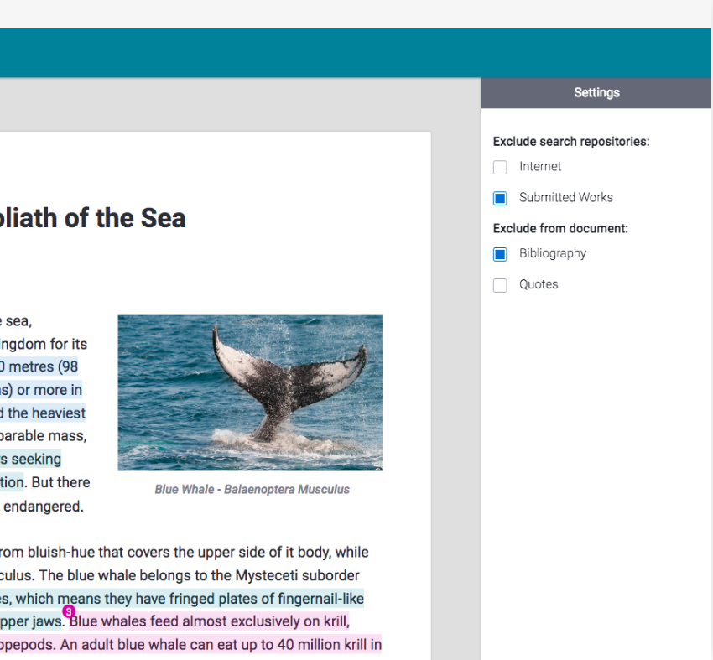
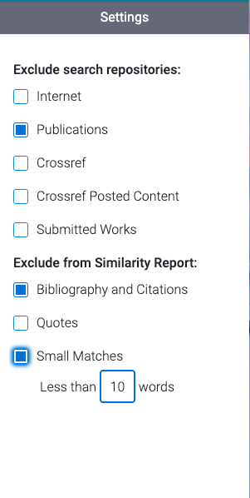
Exclude unwanted content
—
Exclude entire search repositories if you do not want to see matches to them.
Exclude bibliography sections or text in quotes, if Turnitin has detected them.

Slide 16
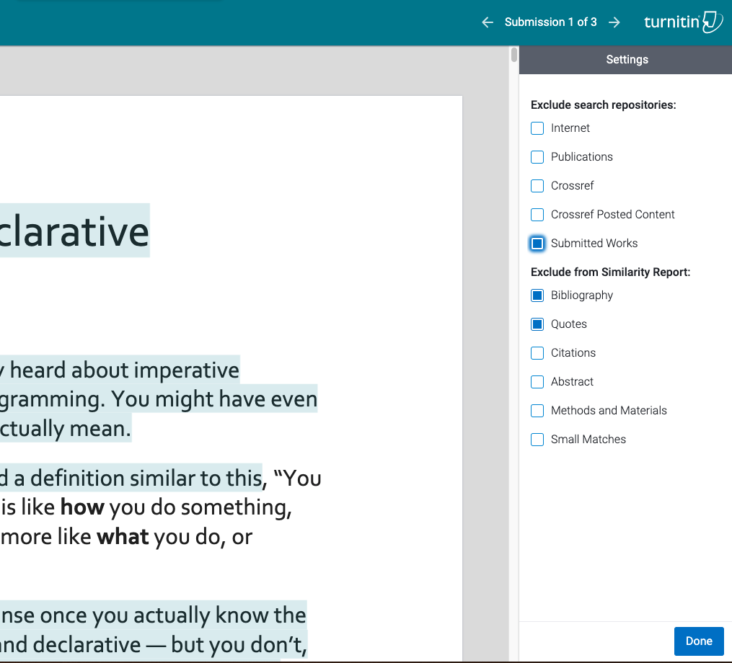




Citation Detection & Exclusion
—
Exclude Bibliography and Citations from the Filters & Settings panel
Exclude citations from Similarity Reports
Exclude citations from the Similarity Report to eliminate insignificant matches and produce a more accurate similarity score.
Grading & Feedback
Helping to...
Increase accuracy of similarity score by reducing noise and false positives in the reports.
Helps students understand where they've properly and improperly cited sources
Instructor
Student

Slide 17
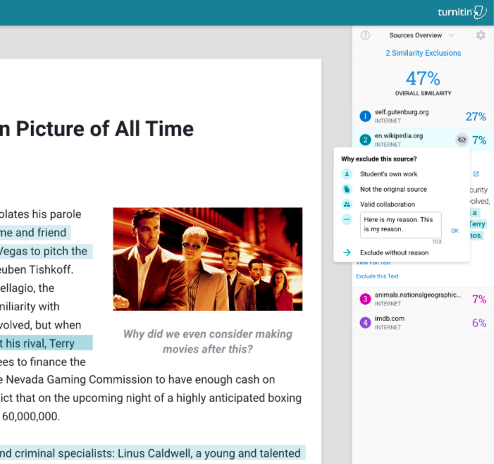
Match Exclusion
—
Dynamically remove matches
Improve the similarity report by removing matches on-the-fly. Choosing a reason why you’d like to remove the match will help make the matching algorithm smarter the next time.
Grading & Feedback
Indicate exclusion reason for improved future results
Helping to…
Make the similarity report more precise to drill in on exactly what both instructors and students need to see.
On-the-fly removal makes it easy to work with the report for quick review.
Instructor
Student
Notes:
This is an example of the citations engine in action. It is powering authorship in this specific example.
We found that the use of mixed citations styles may be a useful indicator of contract cheating. In this case, there’s a visual indicator for each reference that shows at a glance if a mix was used.
(97%+ precision, 90%+ recall)

Slide 18
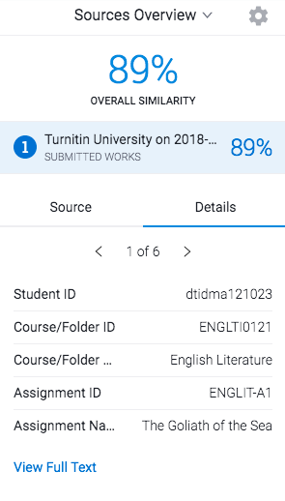
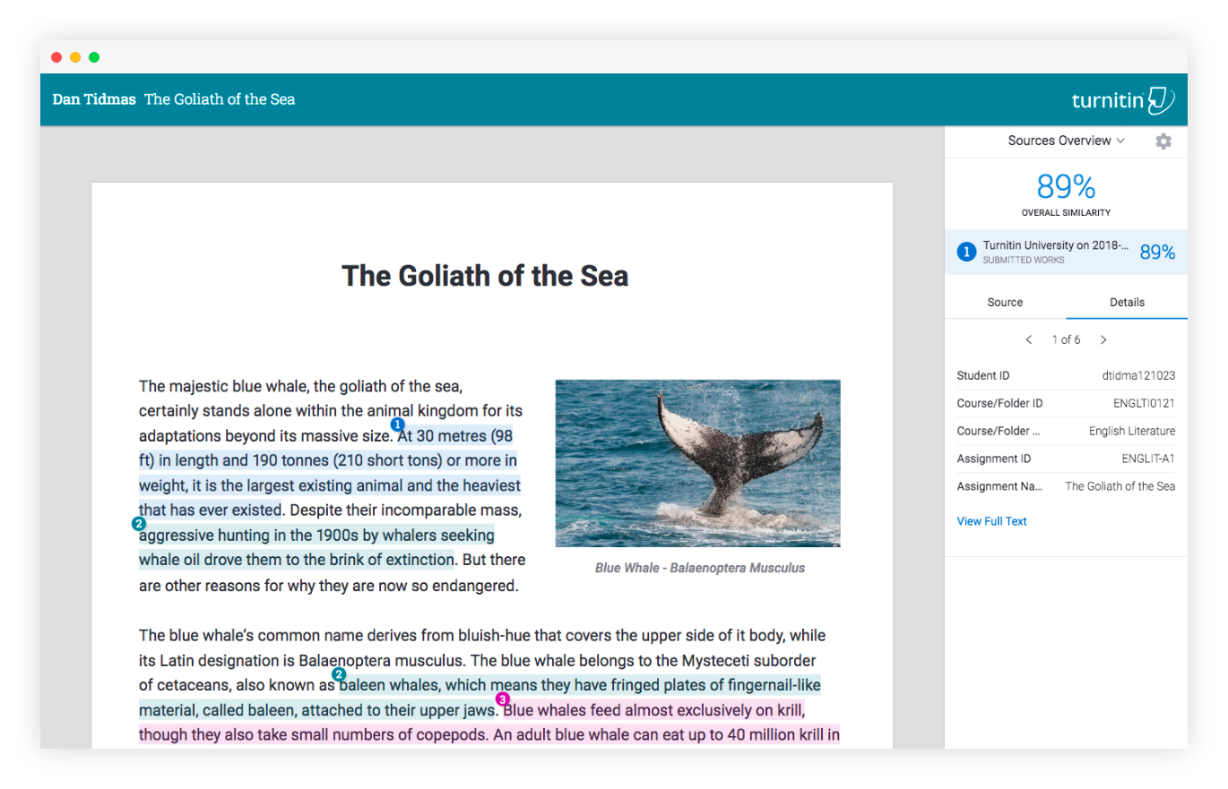
Explore student collusion with ease
—
Easily identify and examine collusion with access to the original paper’s full text.
If we have it, we’ll also provide the author information and class/assignment it was originally submitted to.

Slide 19
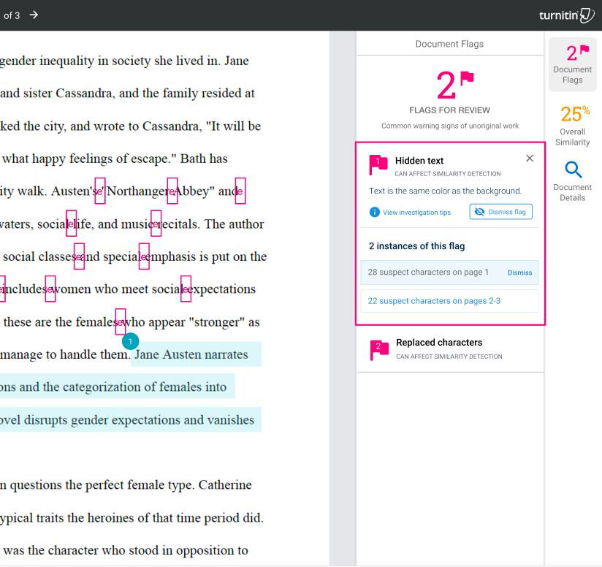

Text Manipulation Flags Panel
—
Highlighting areas of concern
A new panel will illustrate text modifications such as white or extremely tiny fonts, character swapping, excessive quotes, and other changes intended to trick Turnitin’s algorithms.
See anomalies or other indicators of concern
Grading & Feedback
Helping to…
Quickly see text modifications that might not be immediately visible.
Instructor

Slide 20
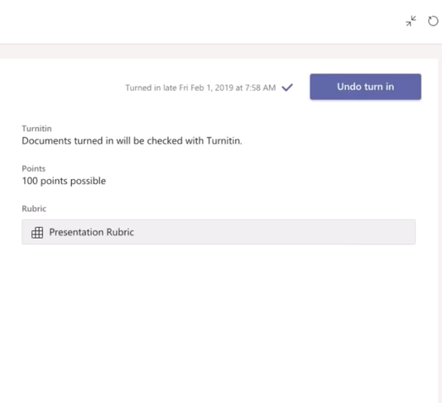
Resubmission via LMS
—
Students can easily resubmit assignments
Undo Assignment Turn In
Students can resubmit their assignment, if the institution enables resubmission options within their LMS
Grading & Feedback
Helping to…
Check work with Turnitin prior to final submission.
Have a flexibility and opportunities for improvement prior to submitting final assignment
Instructor
Student
Notes:
This is an example of the citations engine in action. It is powering authorship in this specific example.
We found that the use of mixed citations styles may be a useful indicator of contract cheating. In this case, there’s a visual indicator for each reference that shows at a glance if a mix was used.
(97%+ precision, 90%+ recall)

Slide 21
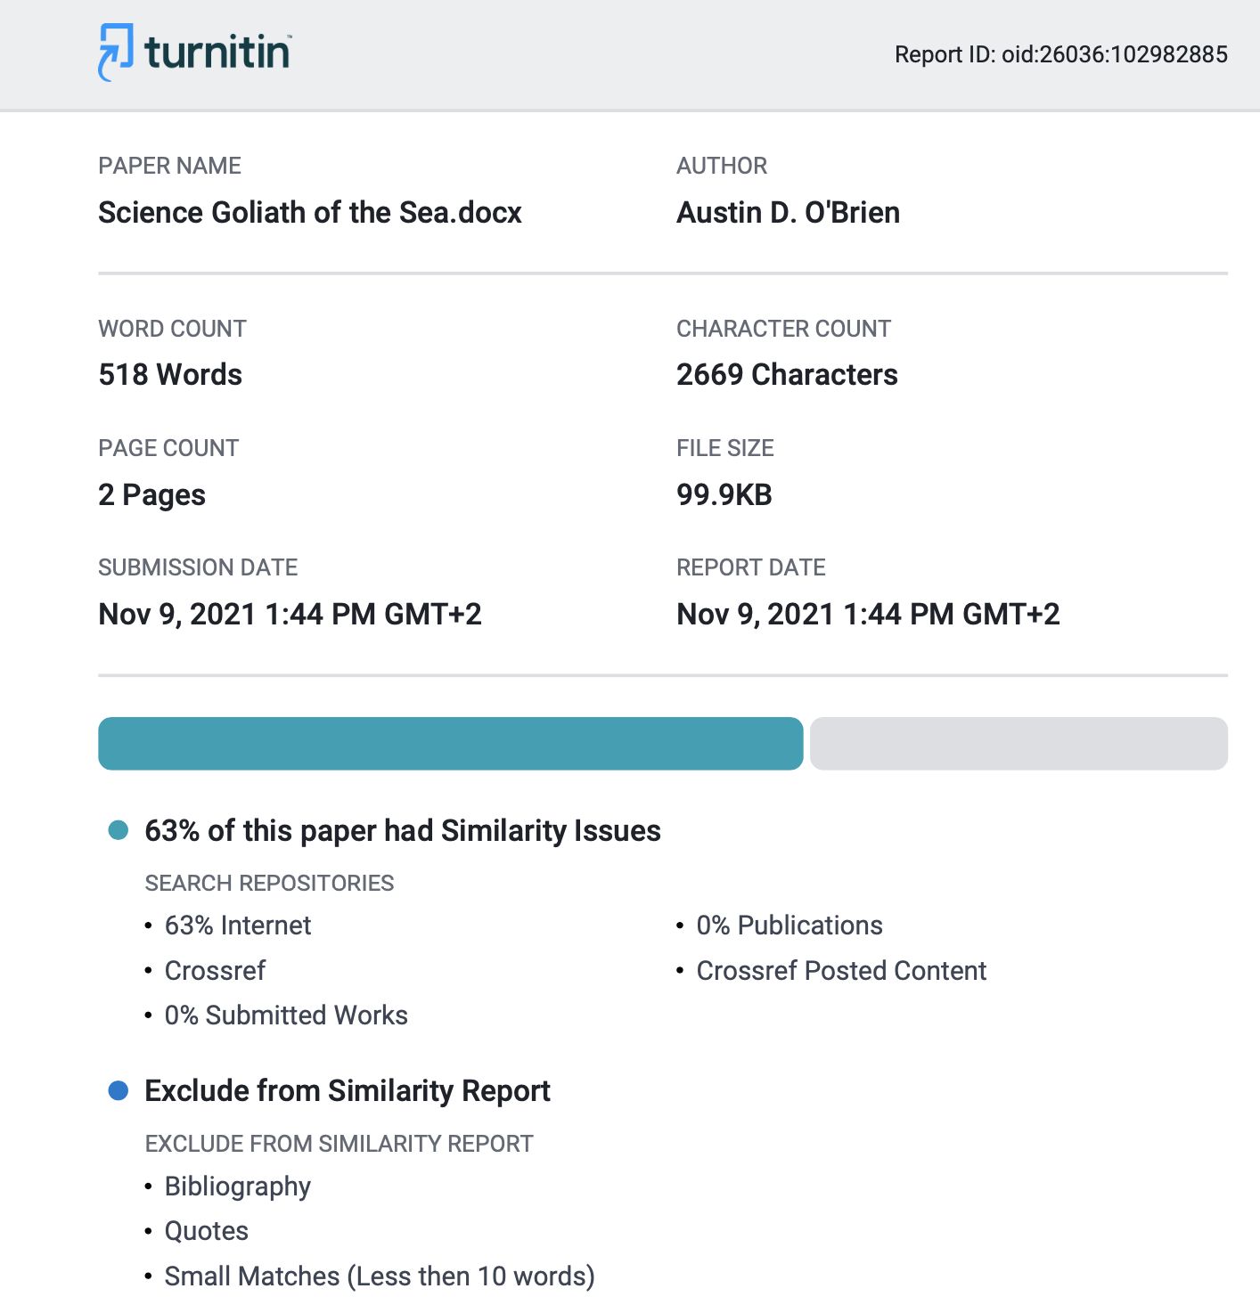

Download and print reports
—
You can quickly export online reports as PDFs with formatting retained or print them out for further review.
The PDF report contains all the required information to identify the student paper along with clickable content sources, exclusions made, color-highlighting and unchanged formatting.

Slide 22


Unicheck vs Similarity
No more further improvements will be made; no new integrations will be added
More future innovations, product enhancements and integrations
Similarity checking: text manipulations (white on white, character replacement); similarity, quotes and citations detection; online and .pdf report with original formatting retained, exclusions
Similarity checking: text manipulations (white on white, character replacement); similarity, quotes and citations detection; online and .pdf report with original formatting retained, exclusions
Search capacity: internet, institutional repository
Search capacity: internet, institutional repository, student papers (global database), scholarly publications
Formative: resubmissions via LMS
Formative: resubmissions via LMS
Folder-based workflow for those who don’t have an LMS
Folder-based workflow for those who don’t have an LMS
Integrations: Plugin (Moodle, Sakai), CPF, API (SmartSchool, Populi), LTI (NEO, Edsby, Schoology, Canvas, Brightspace, Blackboard)
Integrations: Canvas, API ( a wide range of partnerships), MS Teams, Moodle, Sakai, LTI 1.1 (Blackboard, Schoology,D2L), web-based SSO options
Infrastructure: cloud based, modern viewer, accessibility, local data centres
Infrastructure: cloud based, modern viewer, accessibility, local data centres

Slide 23
Demo!

Slide 24



Options to meet your goals
Finding the right solution
AI Writing indicator
Emerging trends such as Contract Cheating and paraphrasing
Draft Coach for Word on the Web and Google Docs
Grading and feedback tools
Draft Coach for Word on the Web and Google Docs
AI Writing indicator
Emerging trends such as Contract Cheating and paraphrasing
Grading & feedback tools
Draft Coach for Word on the Web and Google Docs

Slide 25
Migrating to Turnitin

Slide 26
Unicheck next steps
Key actions to ensuring a smooth transition to Turnitin
Connect with us
Determine renewal status
Determine migration time
1
2
3

Slide 27
We’re standing by to help you start the process
Connect with us
Your next step
Get in touch with us at ucmigration@turnitin.com
Our next step
Answer pricing, data, renewal and migration questions
Key dates
Prior to Dec 2023, but we recommend getting in touch ASAP

Slide 28
You can start the migration or renew your Unicheck contract once if needed
Determine renewal status
Your next step
Migrate to your preferred Turnitin product or renew Unicheck
Our next step
We’ll handle contract paperwork and help you choose a solution
Key dates
Renewal period ends on Dec 31, 2023

Slide 29
Pick the migration time that works best for you
Determine migration period
Your next step
Choose your migration time
Our next step
Provide resources to ensure you know your options
Key dates
Full access to Unicheck ends on Dec 31, 2024

Slide 30
Timeline
Q1 2023
Q2 2023
Q3 2023
Q4 2023
Overview
Monthly Customer Training
Monthly Customer Training
Monthly Customer Training
Monthly Customer Training
Dec Migration
April 18: informational webinar
June Migration
July Migration
Aug Migration
Renewal period ends
Q1 2024
Q2 2024
Q3 2024
Q4 2024
Monthly Customer Training
Jan Migration
Unicheck End of Life

Slide 31
The migration process a glance
Migration stages
Pre-Migration
Migrating
Post-Migration
Planning the migration at your institution with key stakeholders (ie, technology lead)
Setup, testing, and moving to your chosen Turnitin solution
Supporting end users (instructors & students) and follow-up with Turnitin

Slide 32
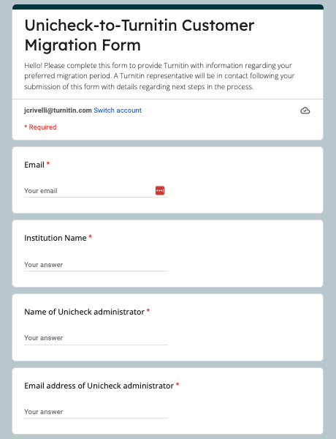
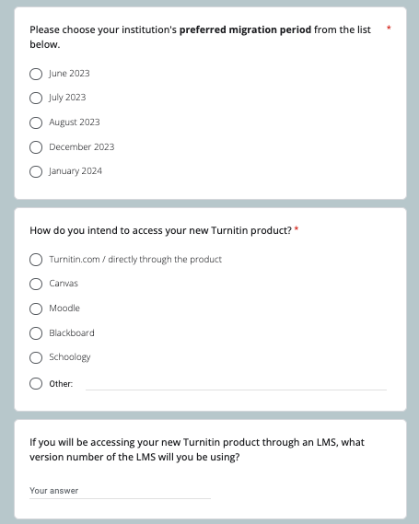
Phase 1: Pre-Migration
Planning your institution’s migration
Connect with us about licensing
Select a migration time that works best for your institution
Key Question:
  When would you prefer to access your new Turnitin solution?

Slide 33




Phase 1: Pre-Migration (cont.)
Planning your institution’s migration
Collaborate with your institution’s tech lead to identify integration and data privacy requirements
Complete all paperwork
Key Questions:
  Will you need to vet your chosen product?
  Are stakeholders aligned on next steps?

Slide 34
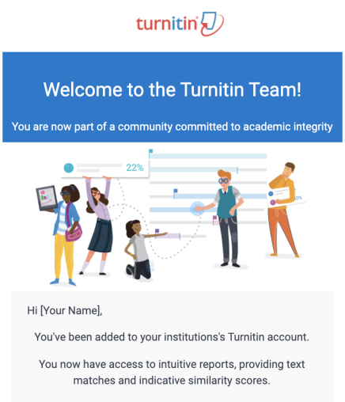
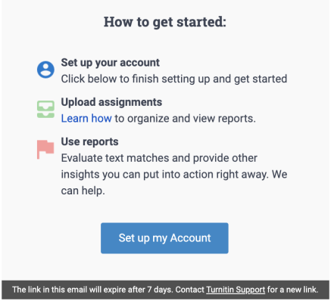
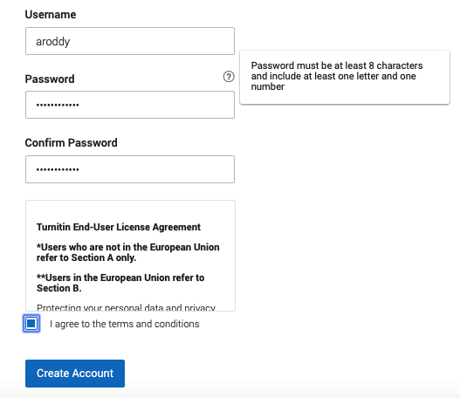
Phase 2: Migrating
Setting up and testing your new solution
When your migration window opens, you will get a link to set up your account
Key actions:
  Set up Turnitin account
  Dual access to compare your new solution to Unicheck experience
Key questions:
  Are your tests working?

Slide 35
Phase 2: Migrating (cont.)
We’ll send check-in emails during the process so you stay informed
1 week before migration window
  What to expect: Migration reminder, next steps, and key resources to get started
Day 1 of migration
  What to expect: Migration start reminder, logging in and testing Similarity, training sign up
Day 15 of migration window
  What to expect: Testing check in, training reminder, and additional resources
Day 30 of migration window:
  What to expect: Migration window closing reminder, Unicheck access reminder, and additional training

Slide 36
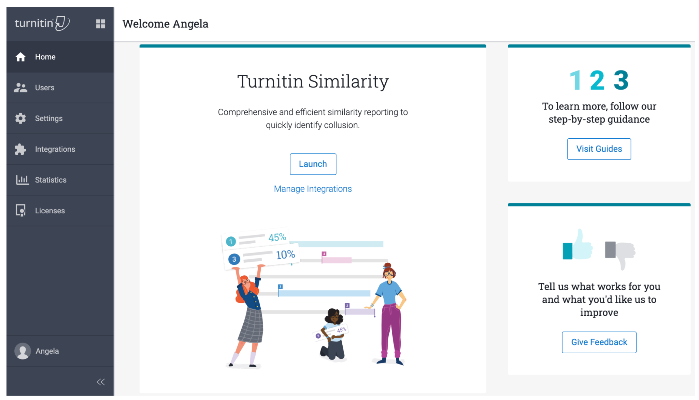
Phase 3: Post-Migration
Settling into Similarity
You have read-only access to Unicheck for 6 months after you migrate
Confirm that all submissions are now made through Turnitin Similarity
Key questions:
  Do you have any outstanding issues that support@turnitin.com can address?

Slide 37
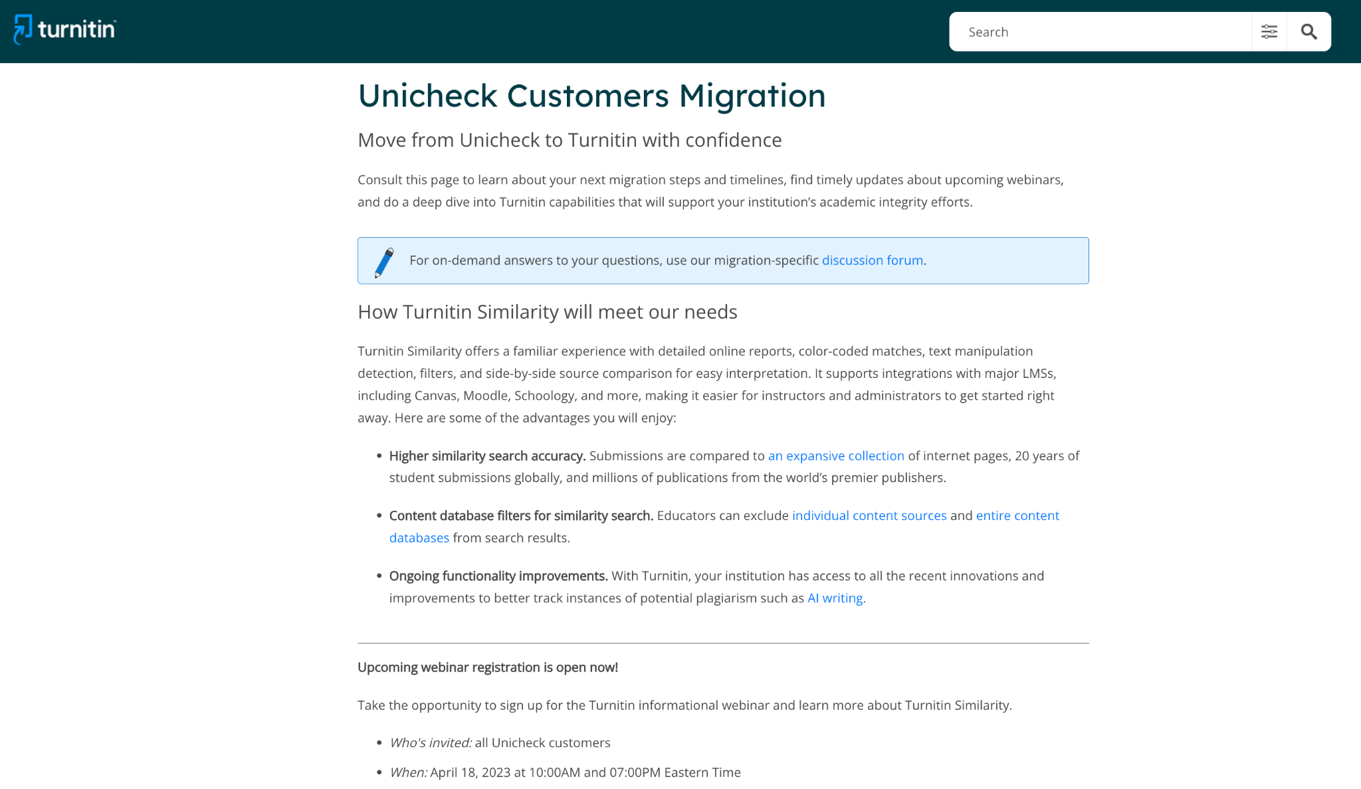
Resources
Ensuring your migration is successful
Our Unicheck Migrations Hub has a number of resources to help you through every step of the migration process.
Helpful links:
  Discussion forum
  Similarity help guides: Administrator
  Similarity help guides: Instructors
  Product transition video

Slide 38
Q&A

Slide 39
Thank you

